Slide 1
Asynchronous Delegation and its Applications
George Dill
October 29, 2019

Slide 2
Asynchronous Delegation and its Applications
Aspirations
George Dill
October 29, 2019

Slide 3
Accomplishments (On our benchmark)
Asynchronous Delegation approaches meet or exceed the throughput achieved by this lab in other delegation designs.
Dedicated Asynchronous Delegation exceeds the throughput of synchronized, shared memory approaches when delegated data structures are cache resident.
Flat Dedicated Delegation performs comparably to synchronized, shared memory approaches when delegated data structures are in DRAM.

Slide 4
Agenda
Background
Shared Memory
Previous Delegation Designs
Asynchronous Delegation Design
Dedicated Asynchronous Delegation
Flat Asynchronous Delegation
Results on Microbenchmark

Slide 5
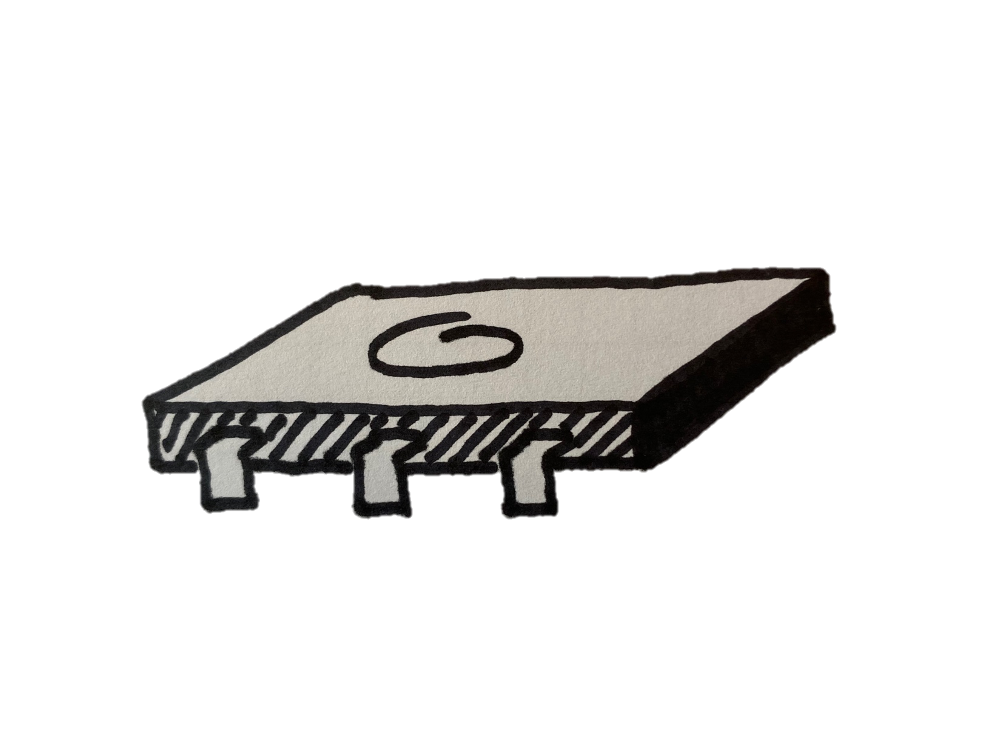
Antecedents – Shared Memory
x += 1
Before x = 1
After x = ?
x += 1

Slide 6
Antecedents – Shared Memory
x += 1
x = {2, 3}
x += 1

Slide 7

Antecedents – Shared Memory

Slide 8
Antecedents – Synchronization By Locks
Execution
Waiting
Execution

Slide 9
Antecedents – Atomic Instruction
XOR %EAX %EAX
LOCK CMPXCHG &LOCK 1
{lock = ?
X = ? }
XOR %EAX %EAX
LOCK CMPXCHG &LOCK 2

Slide 10

Antecedents – Synchronization By Locks
Execution
…
Waiting
Waiting
Execution

Slide 11

Antecedents – FFWD Style Delegation
Will you do x += 1 for me?
Sure, the result is 2.
Client
Server

Slide 12
Antecedents – FFWD API
Function | Description
ffwd_init() | Allocate request / response lines
launch_servers(num_servers) | Launch OS threads for the requested number of servers
thread_create(client_fun, param) | Launch OS threads running the client function specified
ffwd_exec(server, ret, fun, param) | Delegate function fun to server
shutdown() | Stop servers, free request / response lines

Slide 13
Antecedents – FFWD Delegation Design
Request 0
Delegated Data Structure
Request 1
Client 0
Response 0
Server
Response 1
Client 1

Slide 14
Antecedents – FFWD Delegation Design
Request 0
Delegated Data Structure
Request 1
Client 0
Response 0
Server
Response 1
Client 1

Slide 15
Antecedents – FFWD Delegation Design
Request 0
Delegated Data Structure
Request 1
Client 0
Response 0
Server
Response 1
Client 1

Slide 16
Antecedents – FFWD Delegation Design
Request 0
Delegated Data Structure
Request 1
Client 0
Response 0
Server
Response 1
Client 1

Slide 17
Antecedents – FFWD Delegation Design
Request 0
Delegated Data Structure
Request 1
Client 0
Response 0
Server
Response 1
Client 1

Slide 18
Antecedents – FFWD Delegation Design
Request 0
Delegated Data Structure
Request 1
Client 0
Response 0
Server
Response 1
Client 1

Slide 19
Antecedents - Benefits of Delegation
No contention for memory
Spatial locality of memory
On NUMA node allocation of data structures

Slide 20
Antecedents – FFWD Delegation
Polling
Execution
Polling
Server
Generate Request
Waiting
Back to Work
Client
Time

Slide 21
Antecedents – FFWD API
Function | Description
ffwd_init() | Allocate request / response lines
fiber_manager_init() | Launch fiber managers on all system cores
launch_servers(num_servers) | Launch fibers running the server function
fiber_create(client_fun, param) | Launch a fiber running client_fun
ffwd_exec(server, ret, fun, param) | Delegate function fun to server
shutdown() | Stop servers, free request / response lines

Slide 22
Antecedents – Gepard Delegation
Polling
Execution
Polling
Execution
Server
Client
Generate Request
Off Core
Back to Work
Manager
Off Core
Off Core
Off Core
Client
Off Core
Generate Request
Off Core
Client
Time

Slide 23
Asynchronous Delegation
Function | Description
ffwd_init() | Allocate request / response lines
launch_servers(num_servers) | Launch OS threads for the requested number of servers
thread_create(client_fun, param) | Launch OS threads running the client function specified
exec_async(server, cb, fun, param) | Delegate function fun to server, execute callback cb when response is detected
async_barrier() | Clear all outstanding requests before returning.
shutdown() | Stop servers, free request / response lines

Slide 24
Asynchronous Delegation – Comparison to Gepard
Queue 0
…
Request 0
…
…
Queue 32
Request 16
Response 0
…
Response 16

Slide 25
Asynchronous Delegation – Comparison to Gepard
Queue 0
…
Request 0
…
…
Queue 32
Request 16
Response 0
…
Response 16

Slide 26
Asynchronous Delegation – Comparison to Gepard
Queue 0
…
Request 0
…
…
Queue 32
Request 16
Response 0
…
Response 16

Slide 27
Asynchronous Delegation – Comparison to Gepard
Queue 0
…
Request 0
…
…
Queue 32
Request 16
Response 0
…
Response 16

Slide 28
Asynchronous Delegation – Comparison to Gepard
Queue 0
…
Request 0
…
…
Queue 32
Request 16
Response 0
…
Response 16

Slide 29
Asynchronous Delegation – Comparison to Gepard
Queue 0
…
Request 0
…
…
Queue 32
Request 16
Response 0
…
Response 16

Slide 30
Asynchronous Delegation – Comparison to Gepard
Queue 0
…
Request 0
…
…
Queue 32
Request 16
Response 0
…
Response 16

Slide 31
Asynchronous Delegation – Comparison to Gepard
Queue 0
…
Request 0
…
…
Queue 32
Request 16
Response 0
…
Response 16

Slide 32
Asynchronous Dedicated Delegation
Execution
Polling
Execution
Server
Generate Requests
Handle Response
Write Requests
Generate Requests
Client
Time

Slide 33
Asynchronous Dedicated Delegation - Benchmark
Allocate (1) 64Byte variable per server
Vary the number of servers
Total core count sums to 56
Clients select a server at random and delegate an increment function continuously for 3 seconds
Count the total number of operations
Harmonic mean of 10 trials
16 Request Lines unless otherwise mentioned

Slide 34
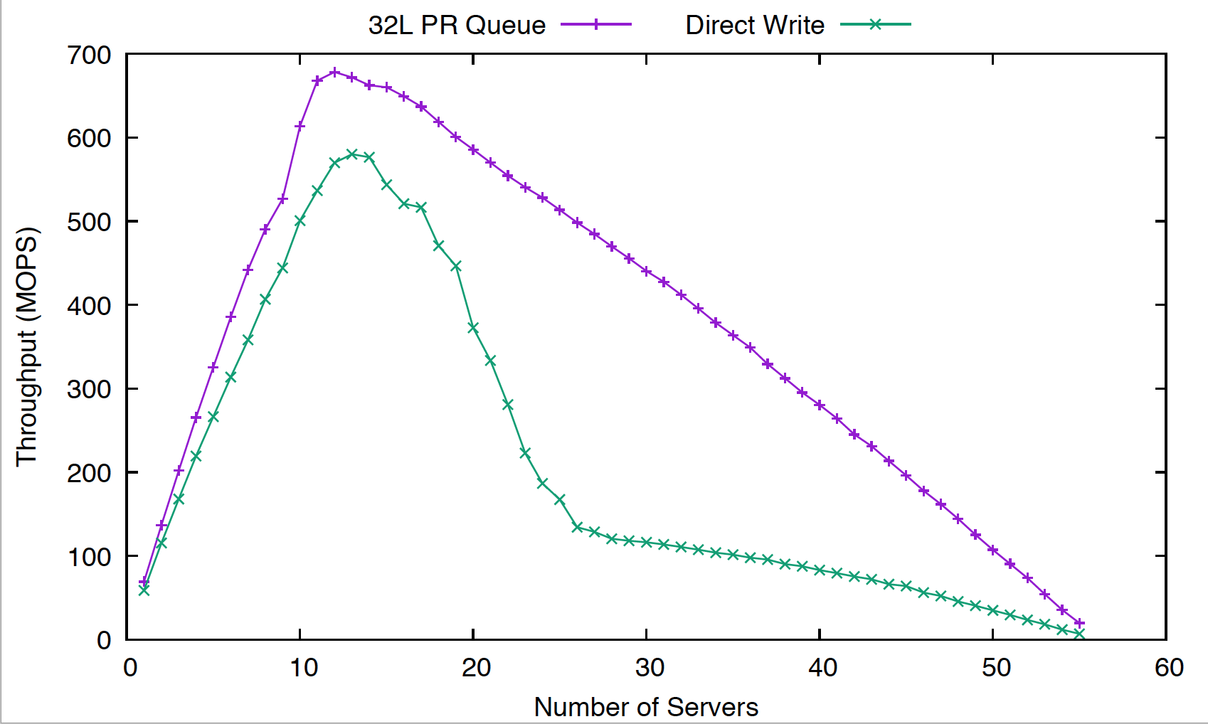
Asynchronous Dedicated Delegation – Why Hold a Request Reserve?

Slide 35
Asynchronous Dedicated Delegation – Request Reserve Implementation
Queue 0
Request 0
…
Queue 0
…
Request 0
…
…
Queue 0
Request 16
…
Queue 32
Request 0
…
…
Request 16
Queue 32
…
…
Request 16
Queue 32
Response 0
…
Response 0
Servers
Response 16
Client
…
Response 0
Response 16
…
Response 16

Slide 36
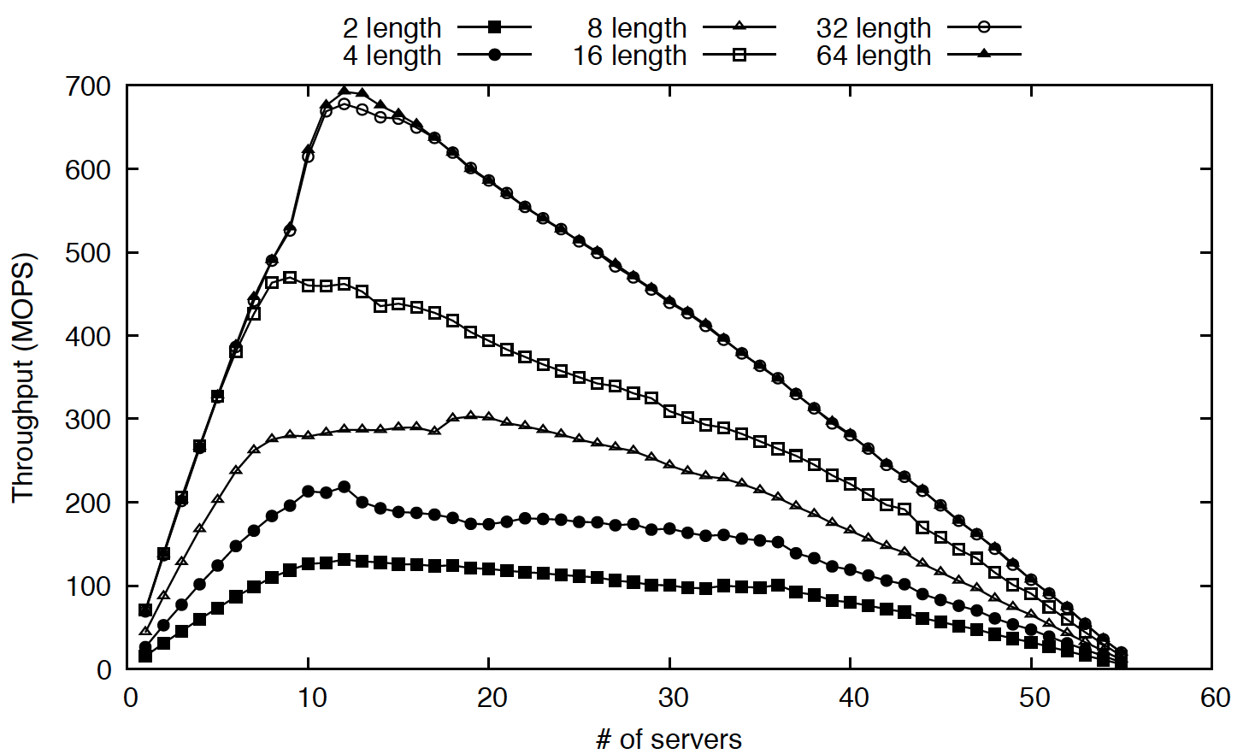
Asynchronous Dedicated Delegation – Pending Request Queue Length

Slide 37
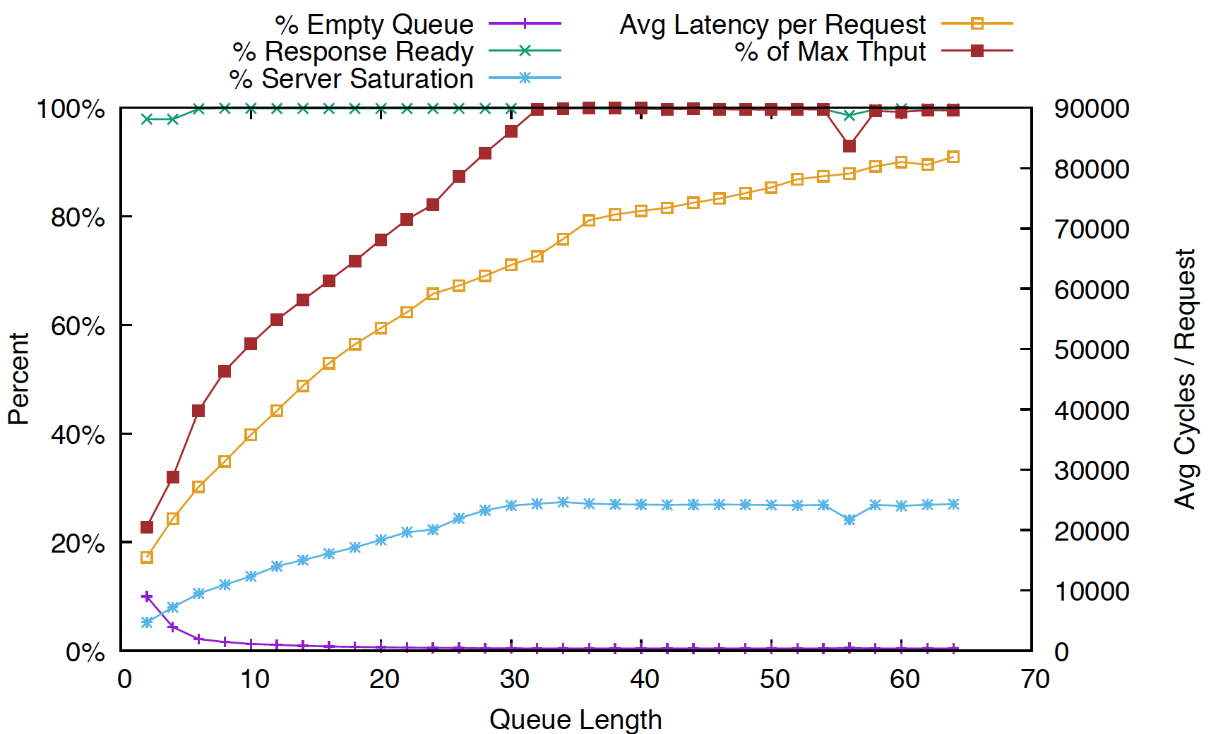
Asynchronous Dedicated Delegation – Pending Request Queue Length
16
Request
Lines

Slide 38
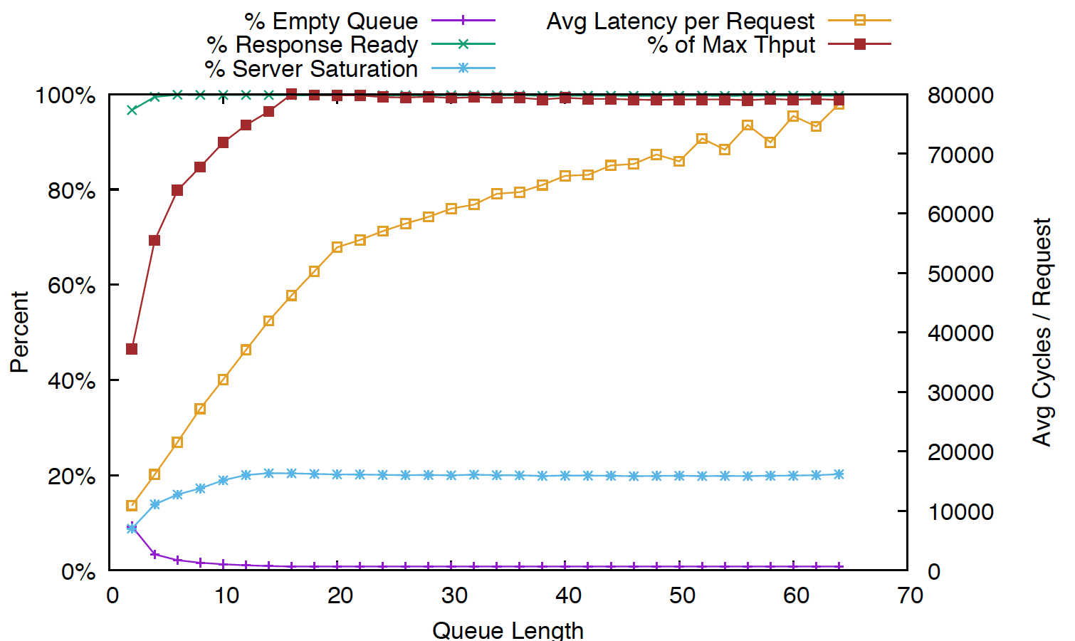
Asynchronous Dedicated Delegation – Pending Request Queue Length
8
Request
Lines

Slide 39
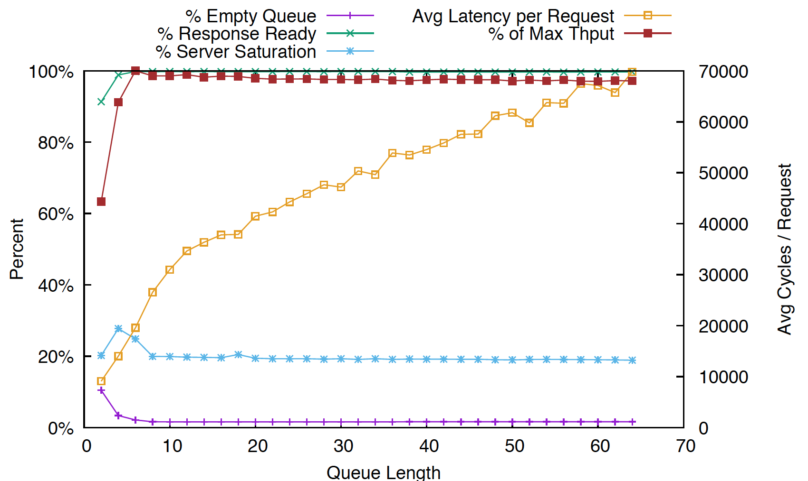
Asynchronous Dedicated Delegation – Pending Request Queue Length
4
Request
Lines

Slide 40
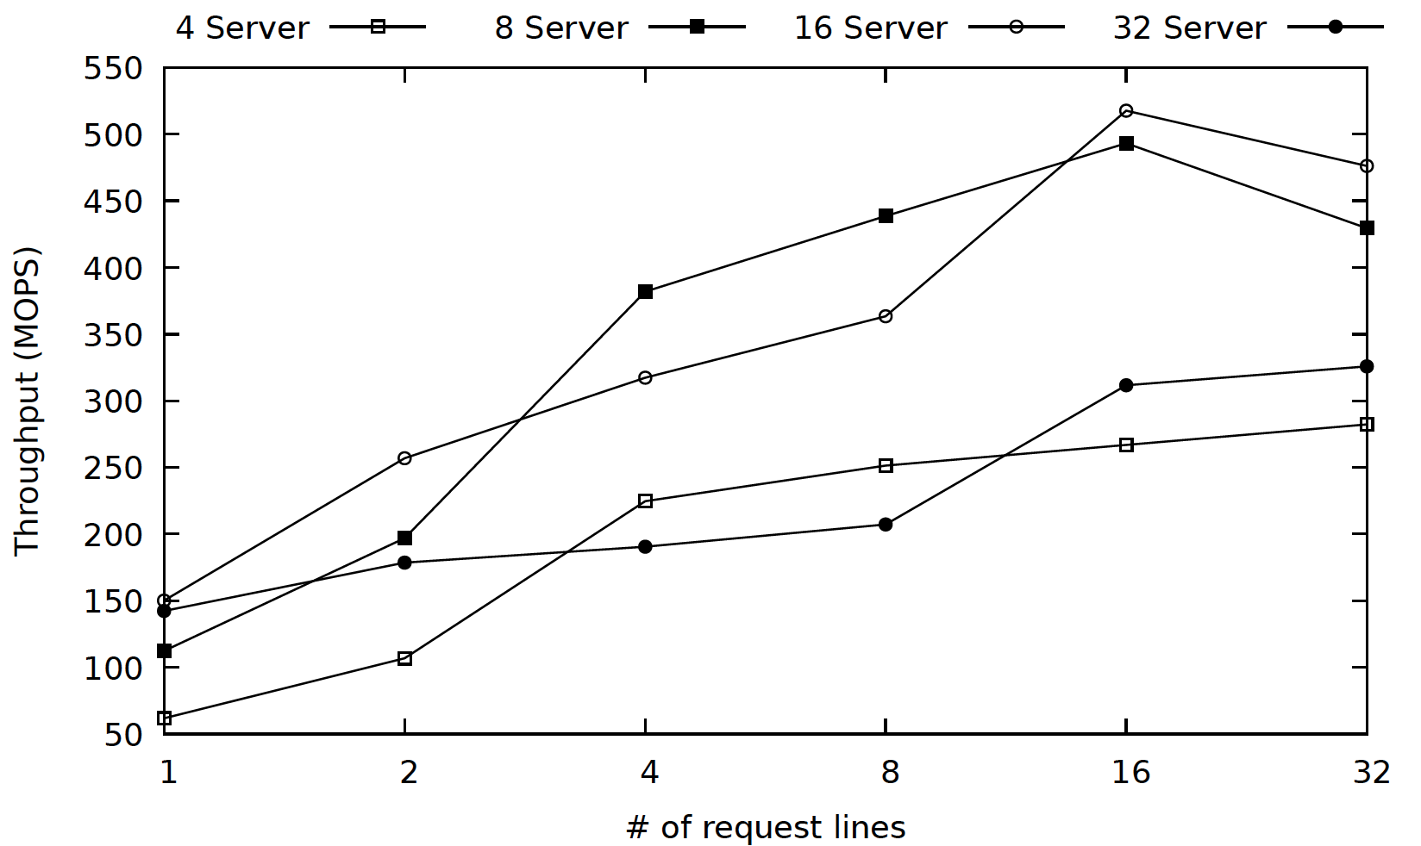
Asynchronous Dedicated Delegation – Number of Request Lines

Slide 41
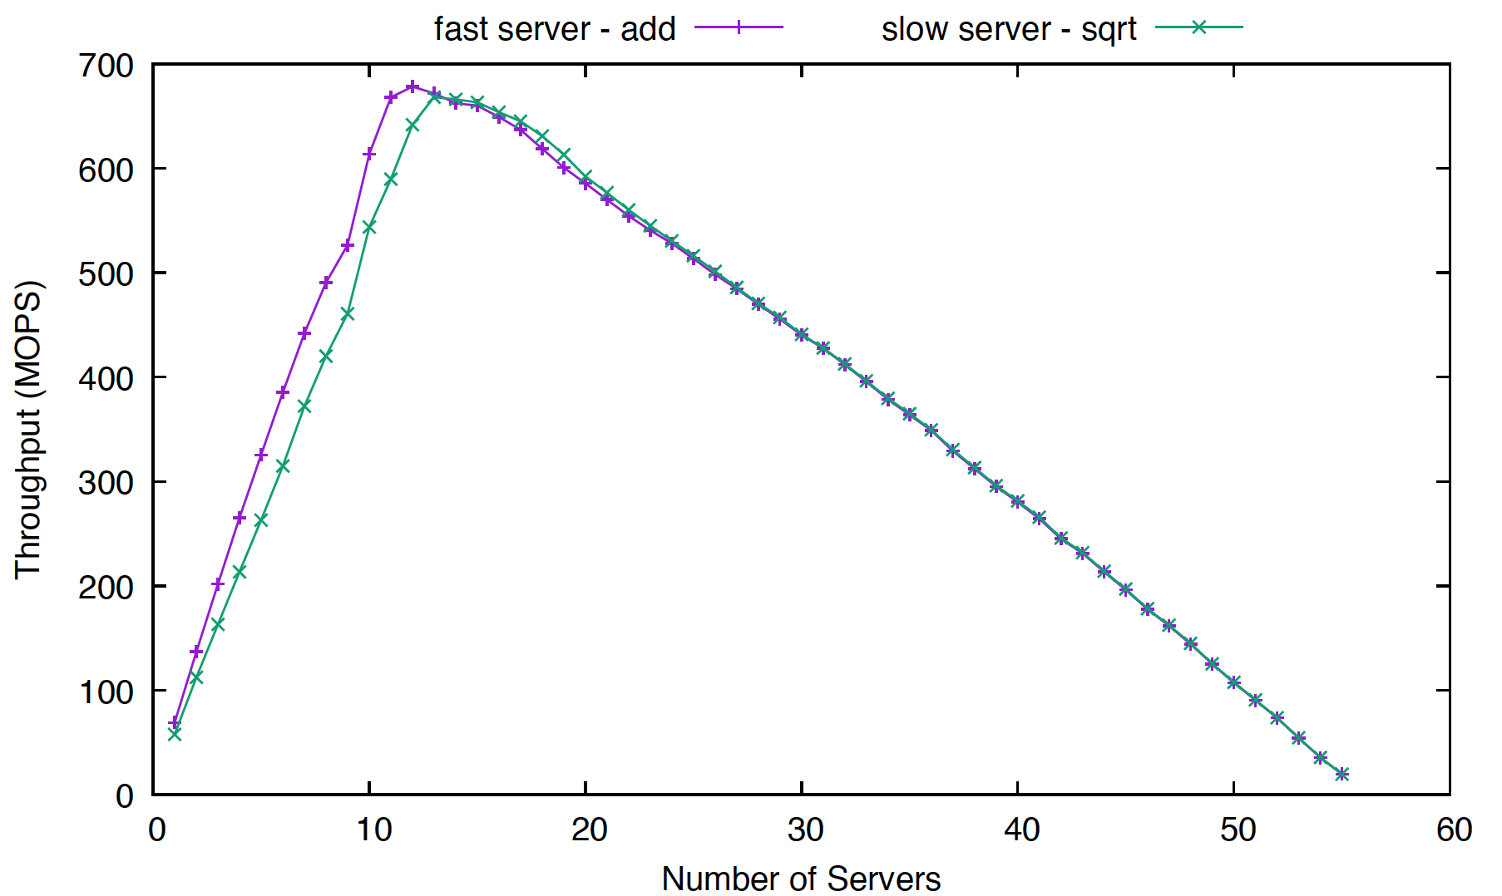
Asynchronous Dedicated Delegation – Client and Server Production Rates

Slide 42
Asynchronous Flat Delegation –Implementation
Queue 0
Request 0
…
Queue 0
…
Request 0
…
…
Queue 0
Request 16
…
Queue 32
Request 0
…
…
Request 16
Queue 32
…
…
Request 16
Queue 32
Response 0
…
Response 0
Response 16
Client
…
Response 0
Response 16
…
Response 16

Slide 43
Asynchronous Flat Delegation –Implementation
Queue 0
Request 0
…
Queue 0
…
Request 0
…
…
Queue 0
Request 16
…
Queue 32
Request 0
…
…
Request 16
Queue 32
…
…
Request 16
Queue 32
Response 0
…
Response 0
Response 16
Client
…
Response 0
Response 16
…
Response 16

Slide 44
Asynchronous Flat Delegation –Implementation
Queue 0
Request 0
…
Queue 0
…
Request 0
…
…
Queue 0
Request 16
…
Queue 32
Request 0
…
…
Request 16
Queue 32
…
…
Request 16
Queue 32
Response 0
…
Response 0
Response 16
Client
…
Response 0
Response 16
…
Response 16

Slide 45
Asynchronous Flat Delegation –Implementation
Queue 0
Request 0
…
Queue 0
…
Request 0
…
…
Queue 0
Request 16
…
Queue 32
Request 0
…
…
Request 16
Queue 32
…
…
Request 16
Queue 32
Response 0
…
Response 0
Response 16
Client
…
Response 0
Response 16
…
Response 16

Slide 46
Asynchronous Flat Delegation –Implementation
Queue 0
Request 0
…
Queue 0
…
Request 0
…
…
Queue 0
Request 16
…
Queue 32
Request 0
…
…
Request 16
Queue 32
…
…
Request 16
Queue 32
Response 0
…
Response 0
Response 16
Client
…
Response 0
Response 16
…
Response 16

Slide 47
Asynchronous Flat Delegation –Implementation
Queue 0
Request 0
…
Queue 0
…
Request 0
…
…
Queue 0
Request 16
…
Queue 32
Request 0
…
…
Request 16
Queue 32
…
…
Request 16
Queue 32
Response 0
…
Response 0
Response 16
Client
…
Response 0
Response 16
…
Response 16

Slide 48
Asynchronous Flat Delegation –Implementation
Queue 0
Request 0
…
Queue 0
…
Request 0
…
…
Queue 0
Request 16
…
Queue 32
Request 0
…
…
Request 16
Queue 32
…
…
Request 16
Queue 32
Response 0
…
Response 0
Response 16
Client
…
Response 0
Response 16
…
Response 16

Slide 49
Asynchronous Flat Delegation –Implementation
Queue 0
Request 0
…
Queue 0
…
Request 0
…
…
Queue 0
Request 16
…
Queue 32
Request 0
…
…
Request 16
Queue 32
…
…
Request 16
Queue 32
Response 0
…
Response 0
Response 16
Server
…
Response 0
Response 16
…
Response 16

Slide 50
Asynchronous Flat Delegation –Implementation
Queue 0
Request 0
…
Queue 0
…
Request 0
…
…
Queue 0
Request 16
…
Queue 32
Request 0
…
…
Request 16
Queue 32
…
…
Request 16
Queue 32
Response 0
…
Response 0
Response 16
Server
…
Response 0
Response 16
…
Response 16

Slide 51
Asynchronous Flat Delegation –Implementation
Queue 0
Request 0
…
Queue 0
…
Request 0
…
…
Queue 0
Request 16
…
Queue 32
Request 0
…
…
Request 16
Queue 32
…
…
Request 16
Queue 32
Response 0
…
Response 0
Response 16
Client
…
Response 0
Response 16
…
Response 16

Slide 52
Asynchronous Flat Delegation – Permutations
Pending Request Reserve
Direct Request Line Write
Serve when blocked
Fast path
Bound by fixed number of invocations
Doorbell

Slide 53
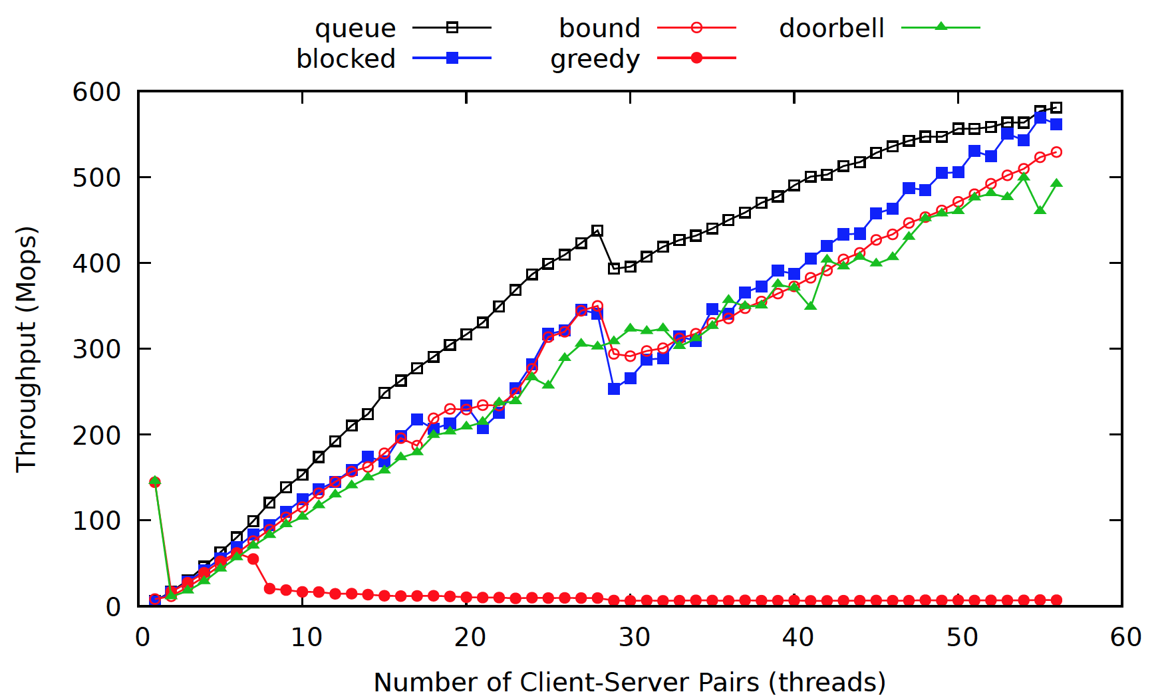
Asynchronous Flat Delegation – Results

Slide 54
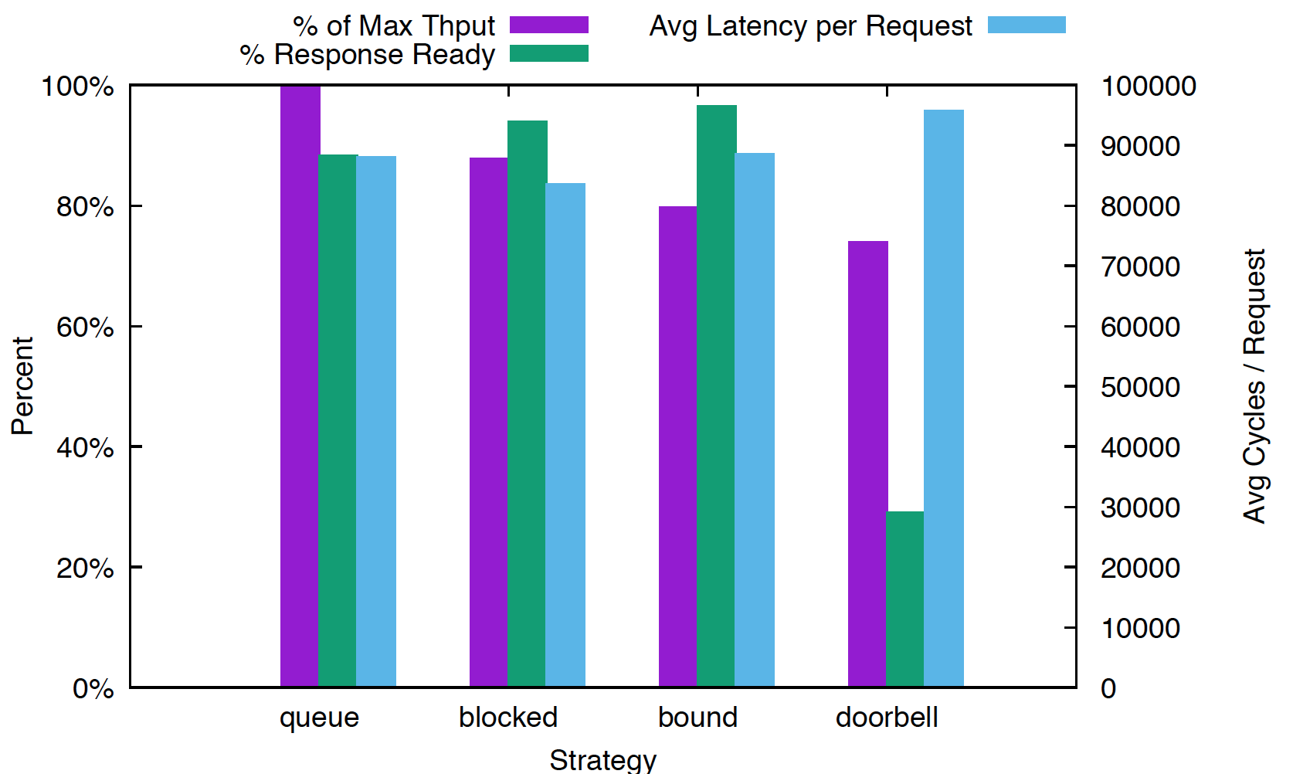
Asynchronous Flat Delegation - Latency
28 Client
Server
Pairs

Slide 55
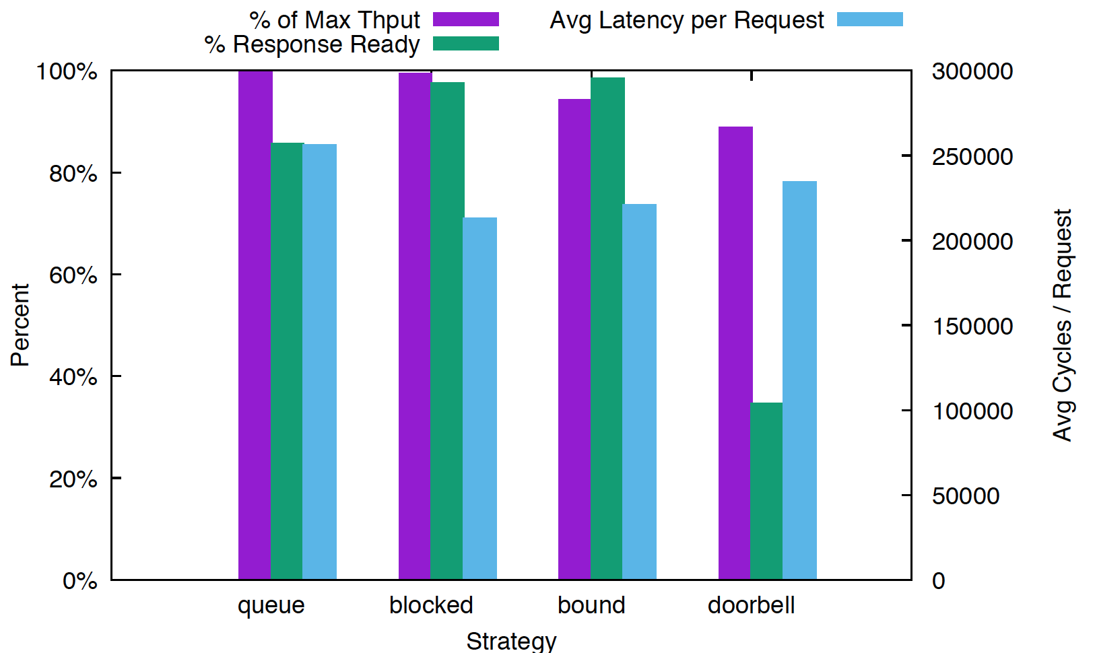
Asynchronous Flat Delegation - Latency
56 Client
Server
Pairs

Slide 56
Results of Microbenchmark
Quads Machines
Intel Skylake (2 ea) 14 core processors for 56 threads
32 KB L1, 1024KB L2 on-core cache
19,712 KB L3 cache per processor
97613732 kB DRAM

Slide 57
Results of Microbenchmark
3 second run time
10 trials
Delegation
Client selects variable at random and delegates an increment function
64 B variables distributed evenly among delegation servers
Allocated as a NUMA-aware 2-d array
Synchronized
Allocated as an array using malloc()
All 56 threads select a variable at random and increment
Uses POSIX mutex and spin lock
Atomic is gcc built in fetch and add.

Slide 58
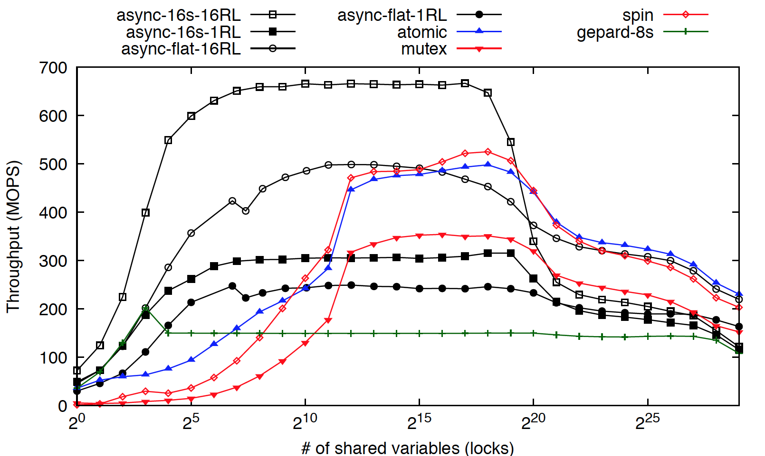
Results

Slide 59
Results

Slide 60
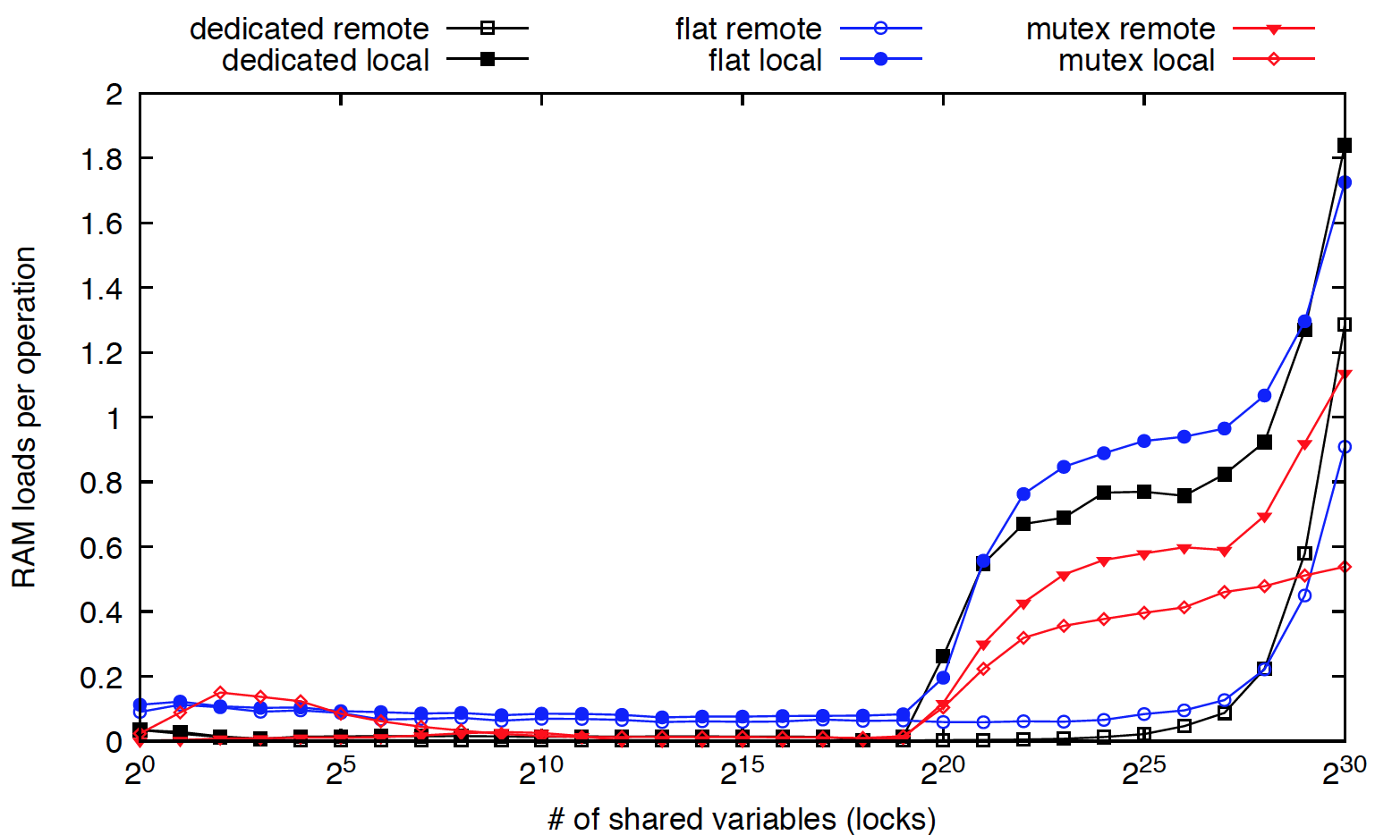
Results

